Slide 1
Breast Cancer
Justin Peter

Slide 2
Datasets
Breast Cancer Wisconsin- larger dataset
http://archive.ics.uci.edu/ml/datasets/breast+cancer+wisconsin+(diagnostic)
Breast Cancer Coimbra- smaller dataset
http://archive.ics.uci.edu/ml/datasets/Breast+Cancer+Coimbra

Slide 3
Techniques
Correlation Matrix
PCA
KPCA
Diffusion Maps
Linear Discriminant Analysis
ROC and AUC curve

Slide 4
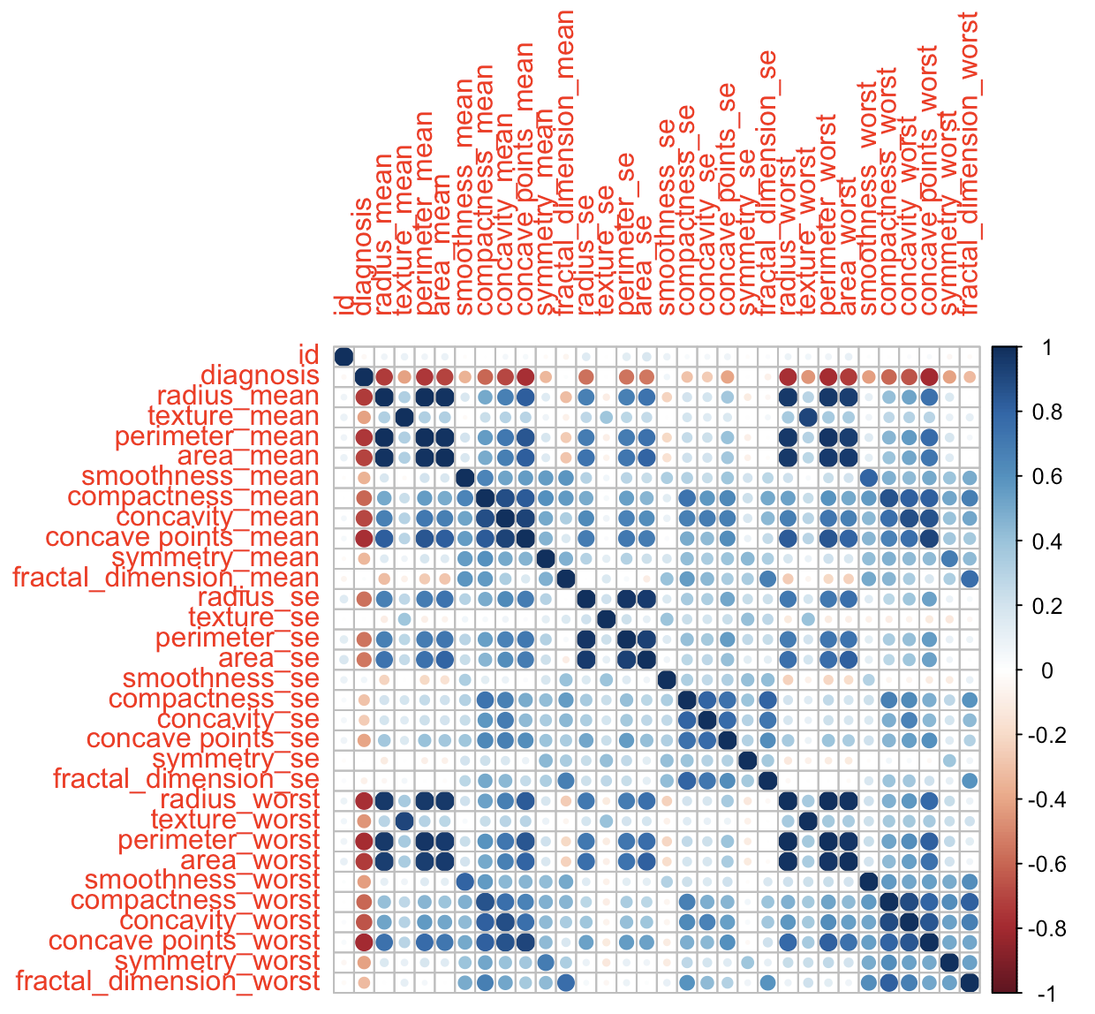
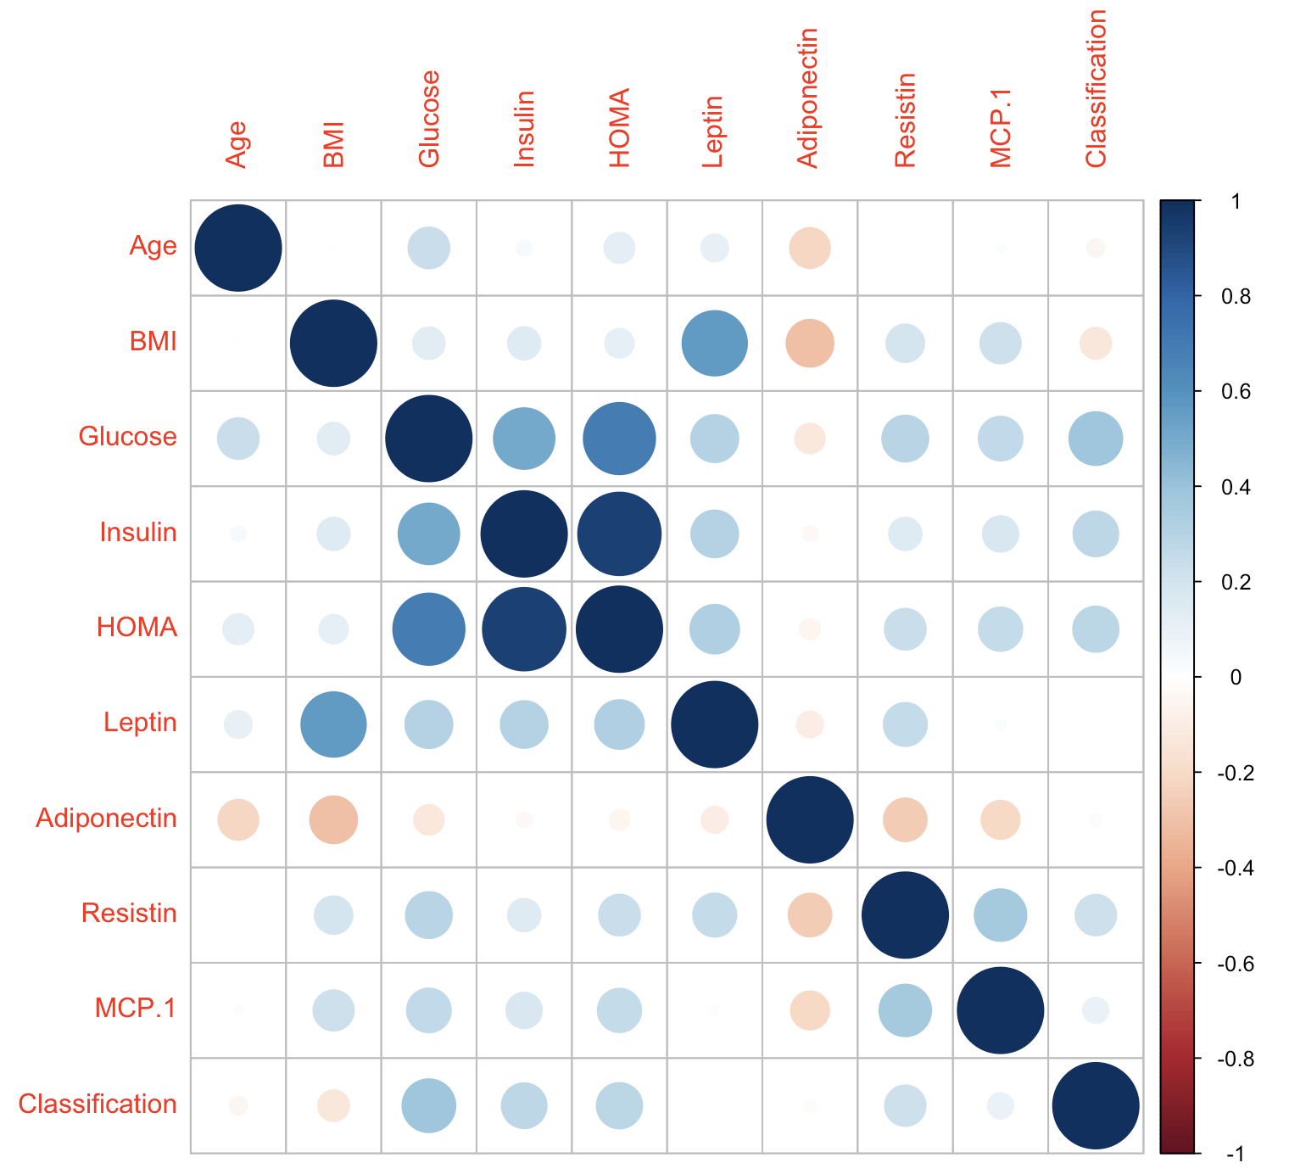
Correlation Matrix

Slide 5
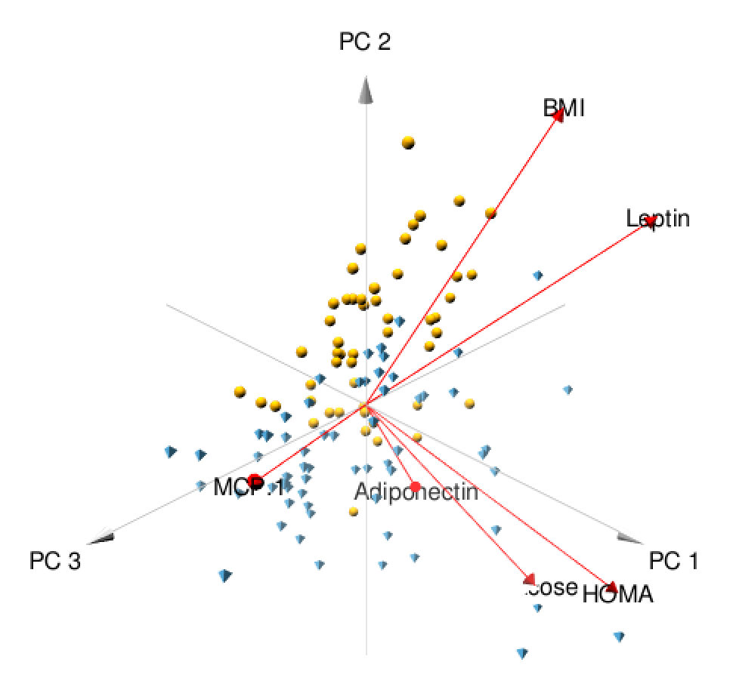
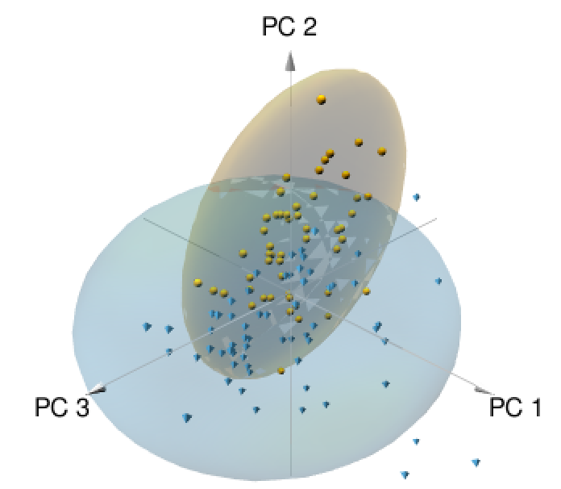
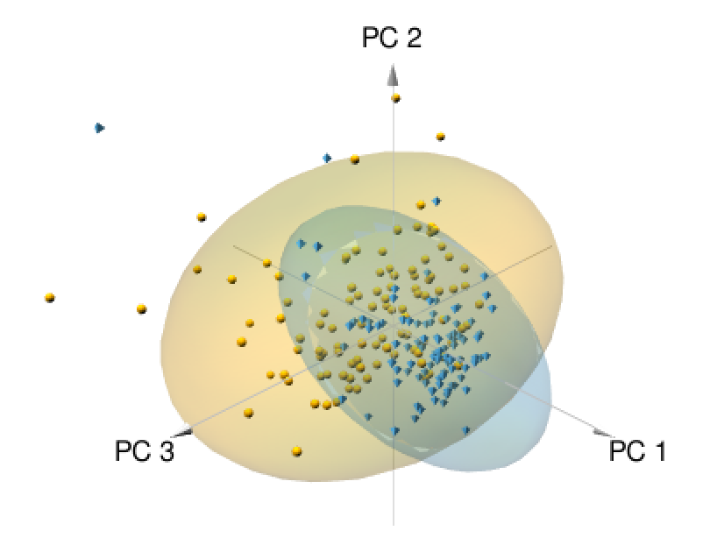
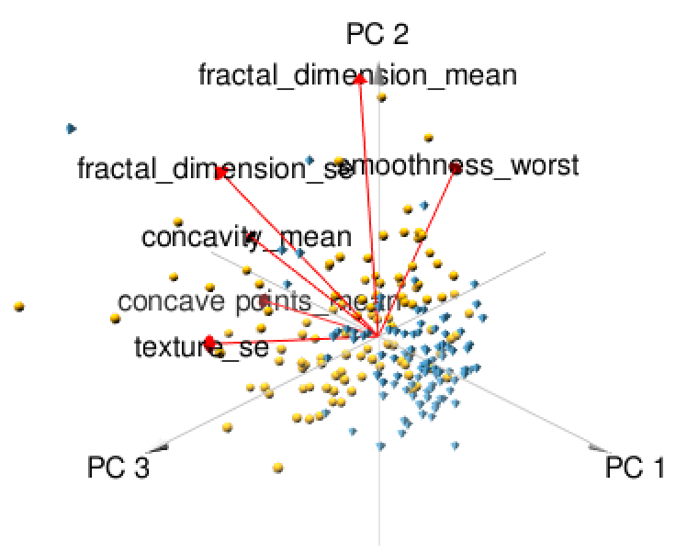
PCA

Slide 6
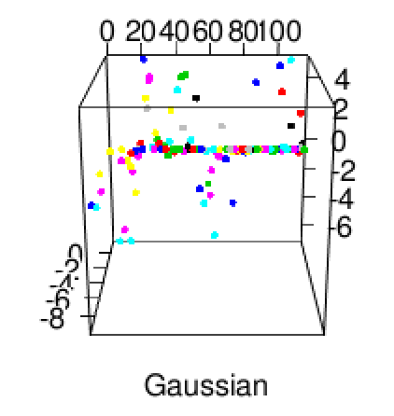
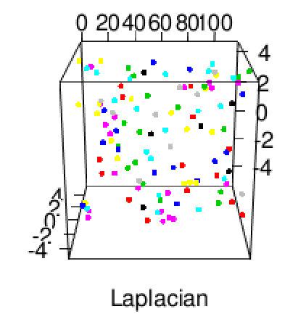
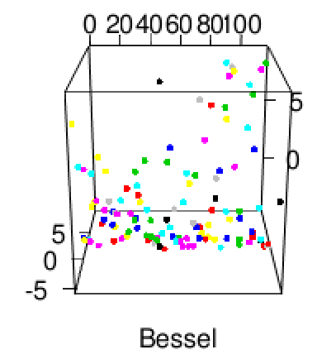
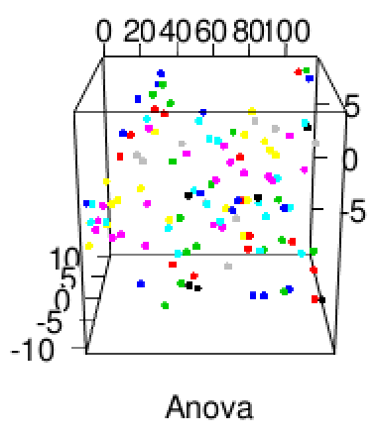
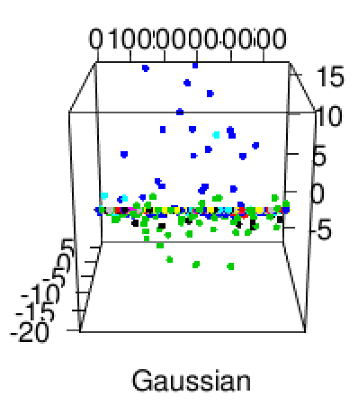
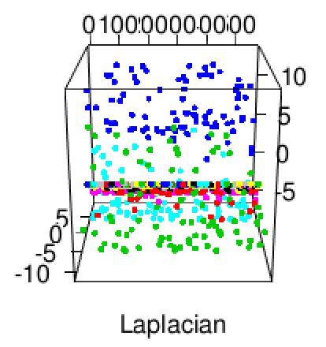
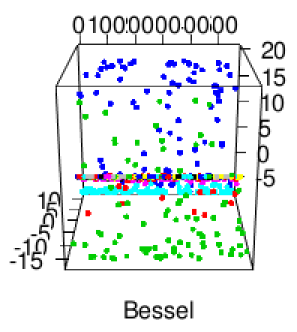
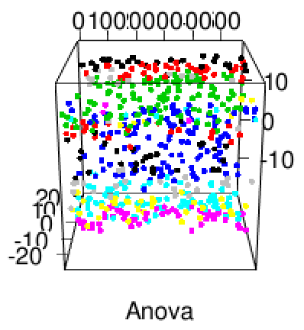
KPCA

Slide 7
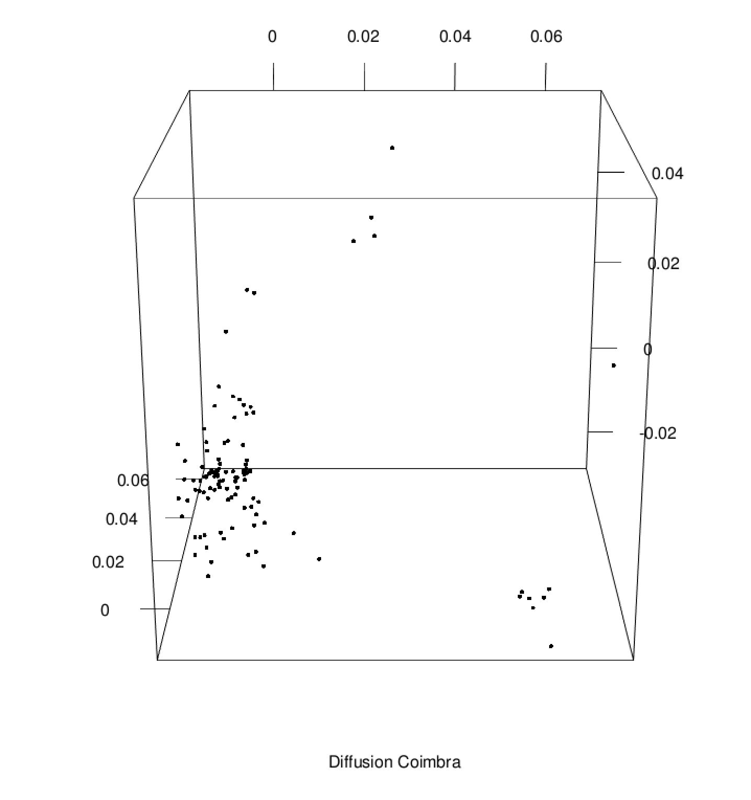
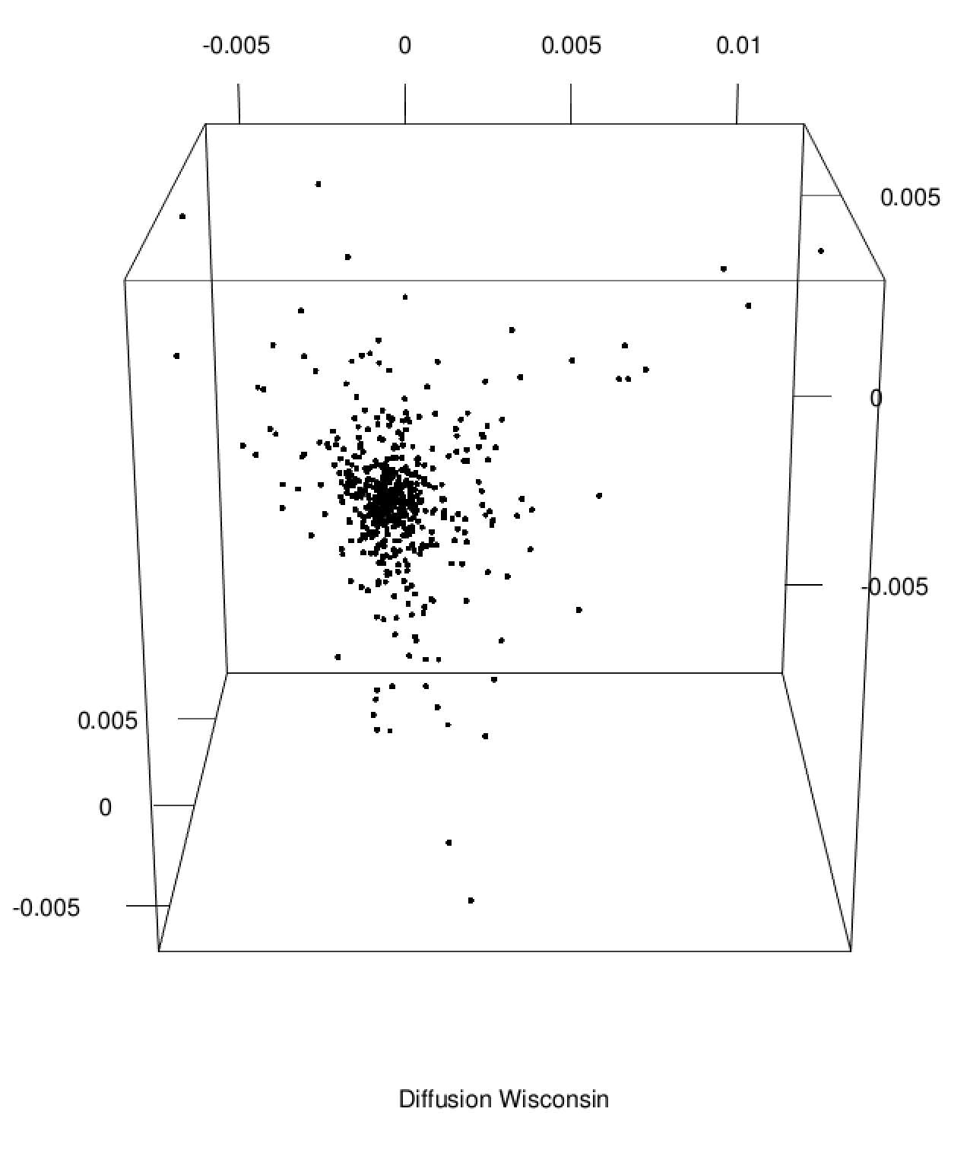
Diffusion Map

Slide 8
Linear Discriminant Analysis
Method to find a linear combination of features that separates two or more classes of objects or events
Used as a linear classifier to predict classification given two labels for a column
ROC- probability curve
AUC- degree of separability
Tells how much the model is capable of distinguishing between classes

Slide 9
Conclusion
We have used PCA, KPCA, and Diffusion Maps to find interesting trends in our data
We used correlation and covariance to see if any variables stand out, but all depend on one another
We constructed a linear classification model that predicts malignant vs benign tumors as well as healthy patients vs none using the percentage of the entire model
We conclude that there is more high potential with Breast Cancer Wisconsin over Breast Cancer Coimbra

Slide 10
Sources
https://www.kaggle.com
https://towardsdatascience.com/understanding-auc-roc-curve-68b2303cc9c5
https://machinelearningmastery.com/linear-discriminant-analysis-for-machine-learning/
https://towardsdatascience.com/classification-part-2-linear-discriminant-analysis-ea60c45b9ee5
Any helpful links on BlackBoard for making the images

